Slide 1
Presidential Effects on the News Media
By Greg McNeil

Slide 2
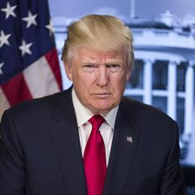
Introduction
The President constantly Tweets about the news media
  Fake News
  Crooked Media
  Low Ratings
Does it have the impact he thinks it has?
Actually damages the financials of media companies?
Damaging of people’s perception of the media?

Slide 3
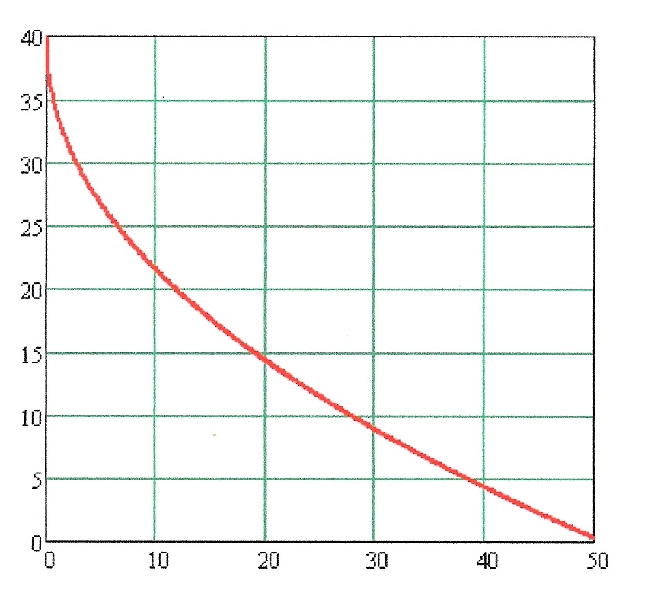


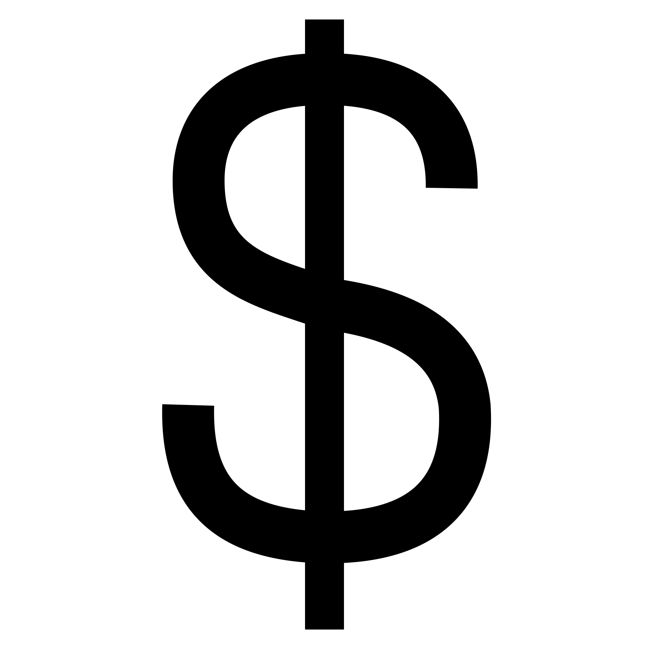
Business Understanding
Media companies make money typically though advertisement
  Lower ratings = less money
  Less credible media = less people watching = less money
Ratings are based on the amount of people who watch the program, not actually what they think

Slide 4
Data Understanding
Dataset
  Pulled all of President Trump’s Tweets (@realdonaldtrump) from twitter
  Total of over 30,000 tweets
  Includes Favorites and Retweets
Preliminary analysis completed in Excel. The results were this table
President Trump gets 10x as many favorites when he tweets about fake news
  What is that doing to the financials and reputation of the Media?
Average RT | Average Fave | Average Fake News RT | Average Fake News Fave
2748 | 9026 | 22,170 | 92,567

Slide 5
Data Preparation
Removed all tweets from before presidential run began
  Kept any tweets after June 6th 2015
  Removed any missing tweets
Removed “tweeted from Android or iPhone” Section
Updated stopwords list to include irrelevent phrases
  Obama
  Realdonaldtrump
  Trump
  Donald
  Etc
Used Wordij to remove stopwords
  Generated .net file
Used Gephi for Modeling

Slide 6
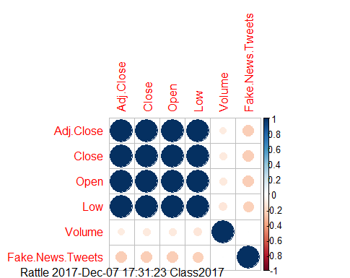
Data Preparation
Pulled the stock price of Time Warner and compared it to the number of CNN related tweets Trump put out
  Assigned each day of the year a value based on how many anti CNN tweets were posted
  Compared that to stock value of Time Warner
Correlation between Trumps Anti CNN tweets and Time Warner’s stock price
  Inversely Correlated
  On average, when Trump creates a CNN tweet, Time Warner’s stock increases

Slide 7
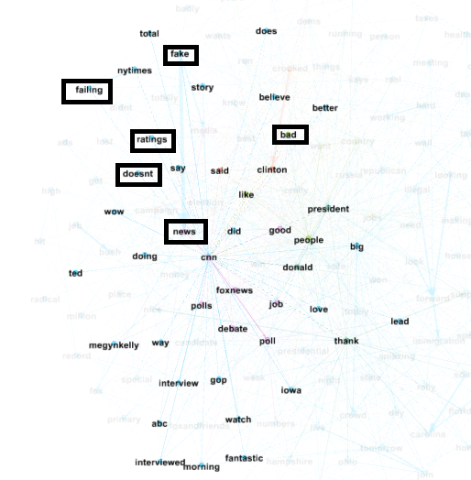
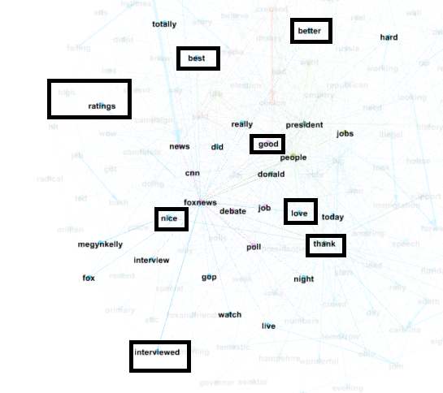
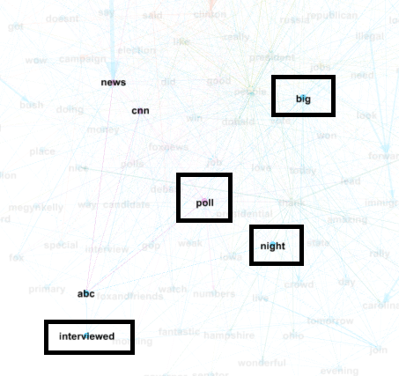

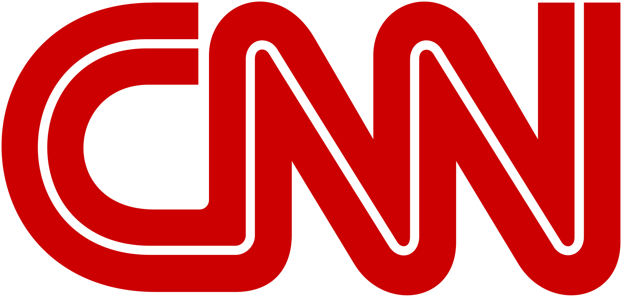
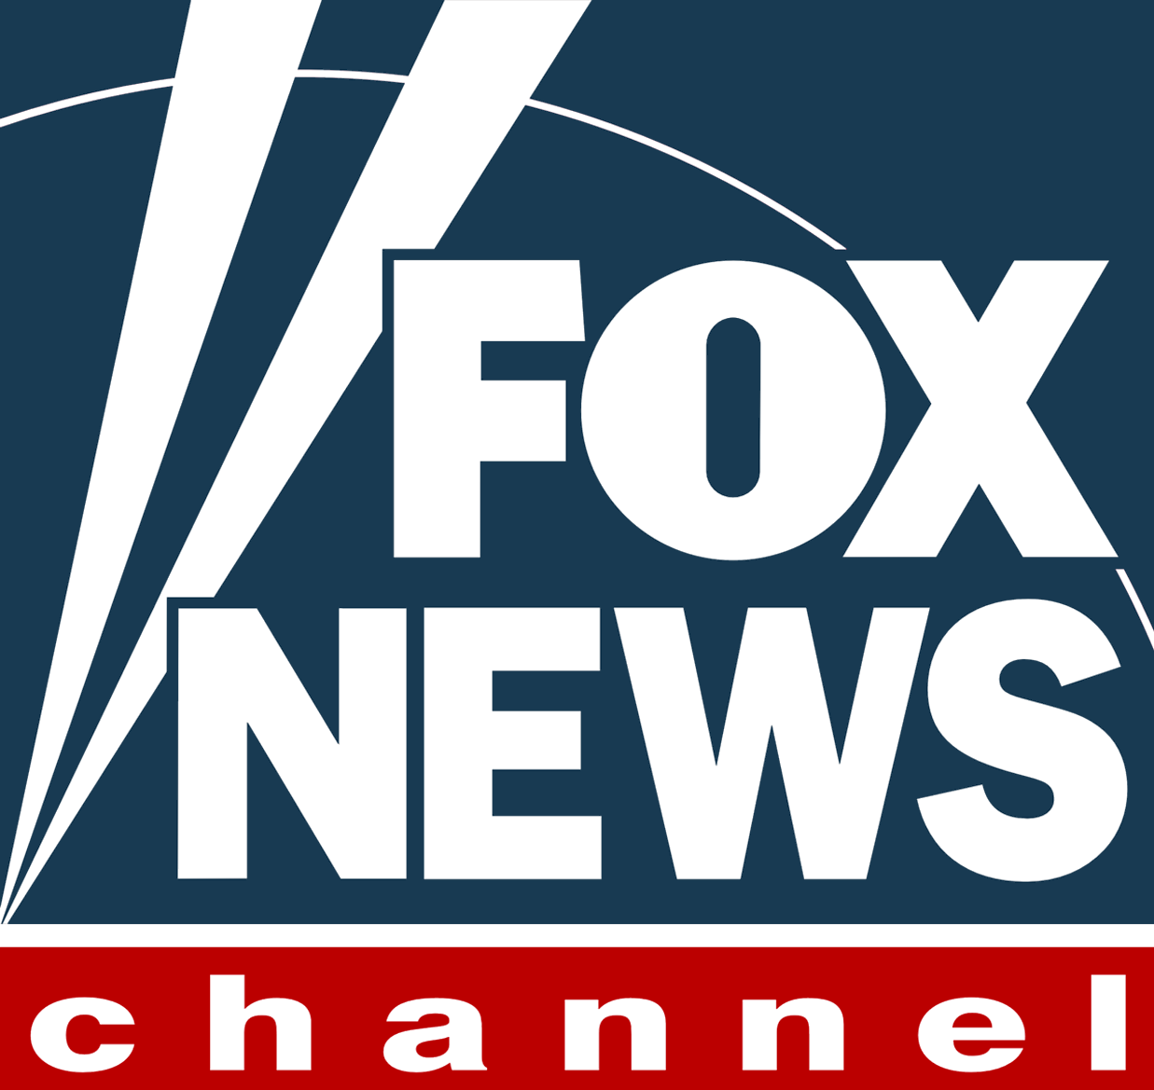
Modeling

Slide 8
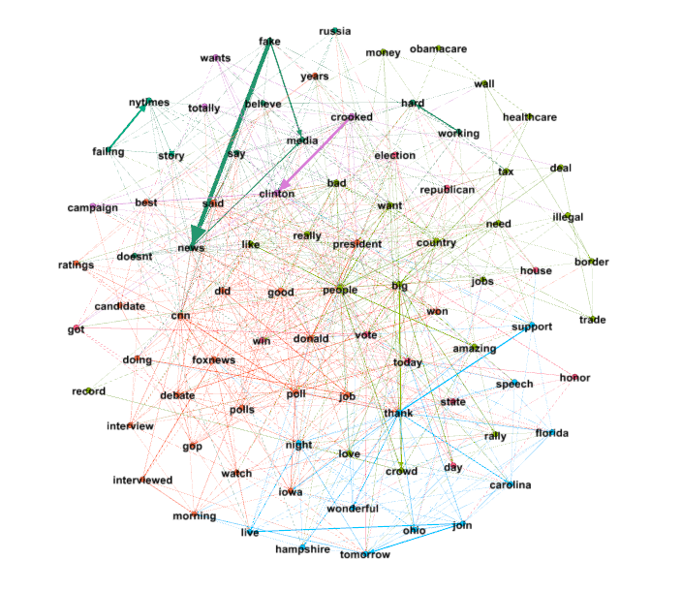
Modeling
Modularity: 0.231
Average Clustering Coefficient: 0.266
Average Degree: 8.824
Nodes: 85
Edges: 750

Slide 9
Evaluation
Top Three news organizations were ABC, CNN, and Fox News
  Fox News was exclusively correlated to positive words and phrases
  ABC was neutrally correlated
  CNN was exclusively correlated to negative words and phrases
CNN Correlated Words/Phrases | ABC Correlated Words | Fox News
Fake News | Interviewed | Nice
Bad Ratings | Big Night | High Ratings
Failing | Poll | Best
Wow |  | Better

Slide 10
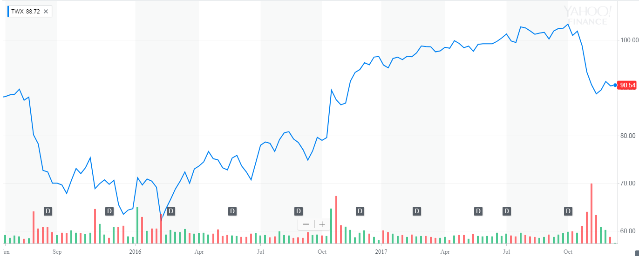
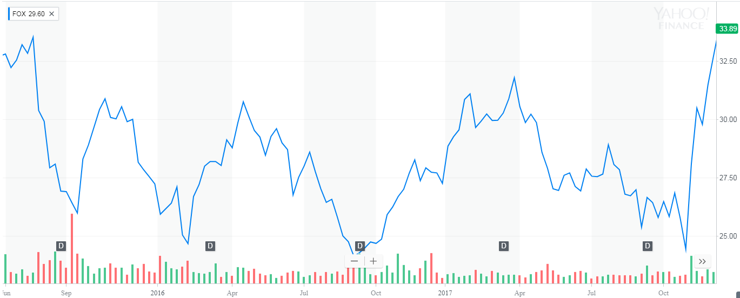
Evaluation
One way to evaluate a news network is through their financials
CNN
  Trending upward since Trump's election
FOX
  Trending average since Trump’s election
CNN (Time Warner)
FOX (Twenty First Century Fox)

Slide 11
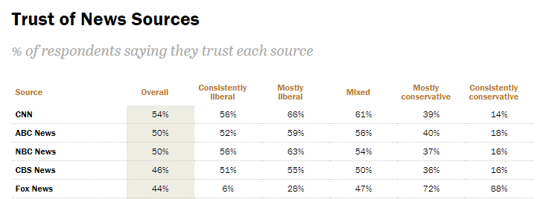
Evaluation
Other way of determining success of a new organization is how trusted they are
Pew poll on how users trust news sources
Both CNN and Fox have poor ratings (high ratings are BBC and NPR)
  Split among partisan lines

Slide 12
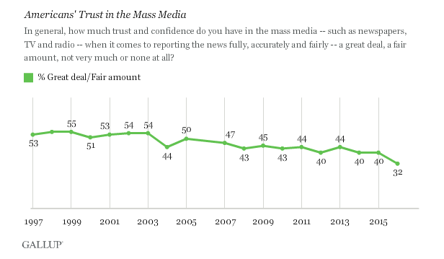
Evaluation
In general, regardless of news network, Americans do not trust the media
  This is being perpetuated by president Trump
  Drop of 8 points, in the past year

Slide 13
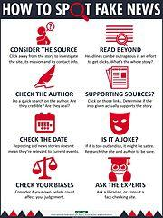
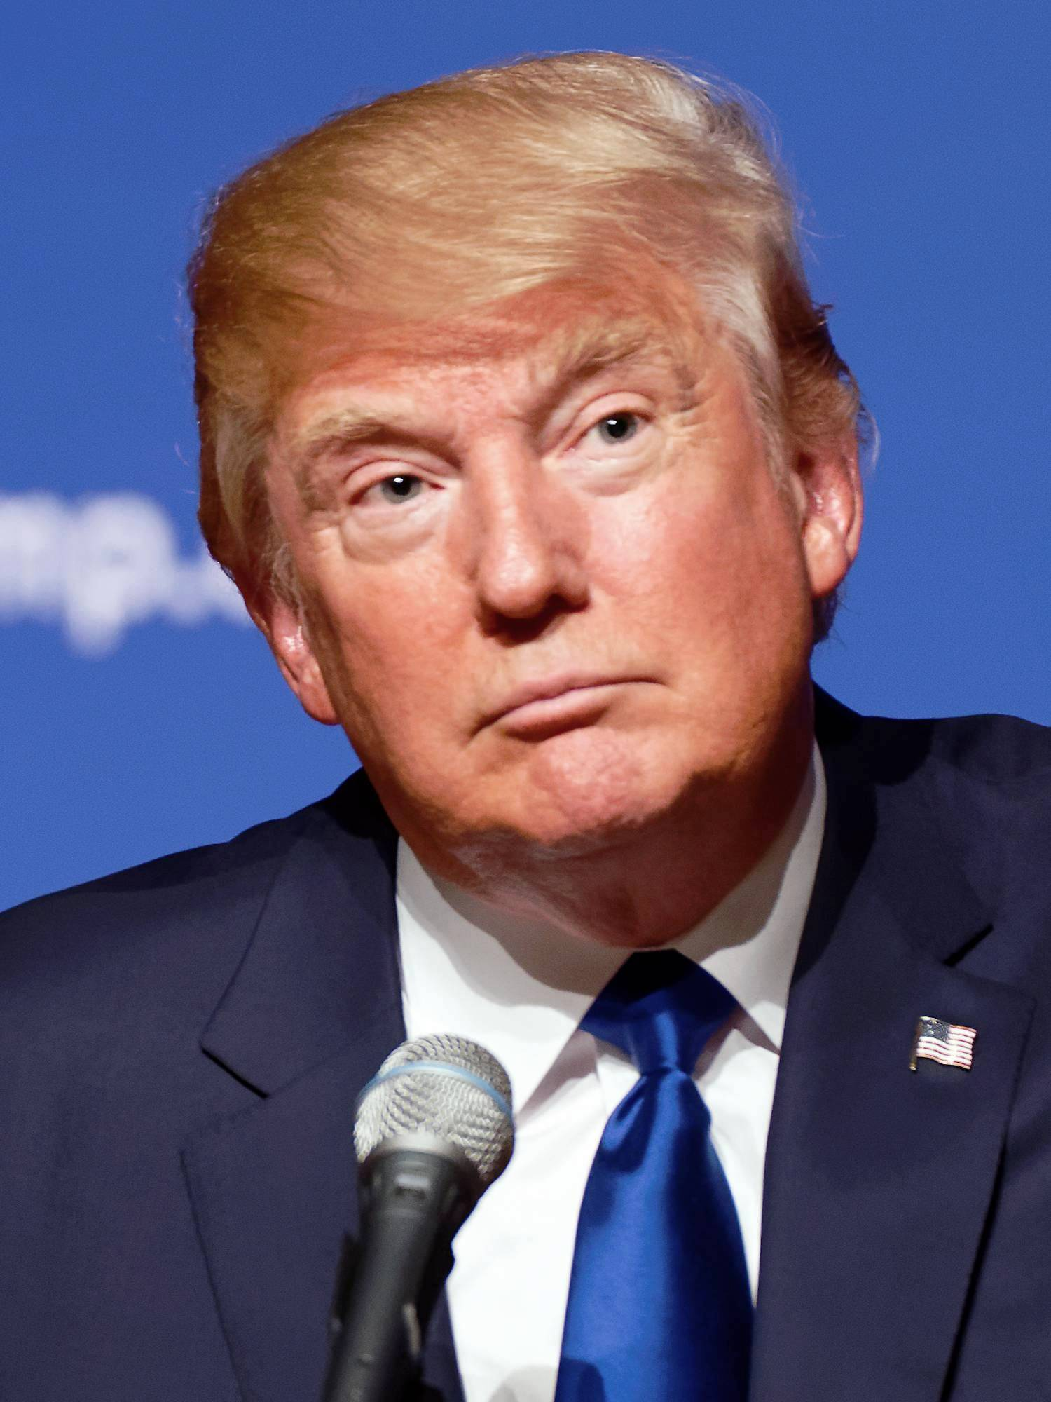
Conclusion and Deployment
President is not negatively effecting news media in the way he wants
  News actually doing better than ever financially
Concerning data is people watch the news but do not believe it
No reason for news organizations to fight back because the president still brings viewers

Slide 14
Thank you!
Questions?

